Slide 1
Predicting Fraudulent Transactions
Using neural networks to detect fraud from credit card transaction data

Slide 2
Introduction
Henry Ver Valen
Masters Program for Data Science - University of Colorado Boulder
Technical Leader at Cisco Systems
Previously at Microsoft, Yahoo!, and several start-ups

Slide 3
Problem Statement
Merchants and banks losses to fraud worldwide exceeded $28 billion in 2020¹
More than 1/3 of this ($11 billion) is in the US alone²
But total value of card transactions was ~$41.9 trillion in 2020¹
Transaction data is very “imbalanced” when looking for fraud
¹ Nilson Report. Card Fraud Losses Worldwide Isssue 1209, December 2021 https://nilsonreport.com/upload/content_promo/NilsonReport_Issue1209.pdf
² Hospitality Technology. One-Third of World's Credit Card Fraud is Traced Back to USA, December 28, 2021 https://hospitalitytech.com/one-third-worlds-credit-card-fraud-traced-back-usa

Slide 4
Can Fraudulent Transactions Be Detected Using a Neural Network?
Using an autoencoder architecture
Jupyter notebook and data available at https://github.com/clayv/DTSA-5511_Final

Slide 5
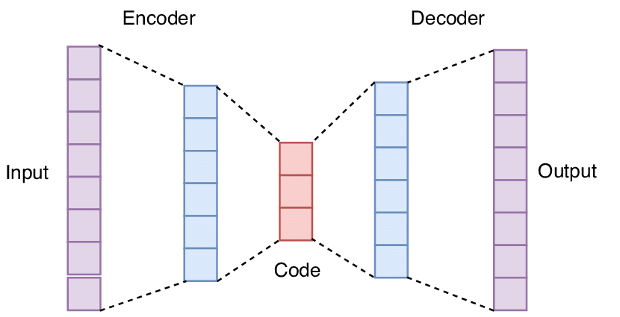
What is an Autoencoder?
Image Credit: Applied Soft Computing. Deep learning for financial applications : A survey, May 2020 https://www.researchgate.net/publication/341292744_Deep_learning_for_financial_applications_A_survey

Slide 6
The Data
Credit Card Fraud Detection dataset from https://www.kaggle.com/datasets/mlg-ulb/creditcardfraud
Transactions made by credit cards over 2 days in September 2013
284,807 total transactions
492 fraudulent transactions (0.172%)
30 Features and 1 Response variable
28 features labeled simply V1, V2, … , V28
Original features and background information V1 – V28 not available

Slide 7
Dataset Challenges
Classes in dataset are heavily imbalanced
99.83% valid transactions
0.17% fraudulent transactions
No information regarding 28 of the 30 features

Slide 8
Why an Autoencoder instead of Principal Component Analysis?
Principal Component Analysis (PCA) requires linear relationship between features and response
No information regarding 28 of the features hampers determining relationship
Autoencoder does not have linear relationship restriction
Autoencoder “learns” most salient features

Slide 9
Results
Model Description | AUC Score | F1 Score
One Layer | 0.9816 | 0.9271
Two Layer | 0.9837 | 0.9223
Three Layer | 0.9863 | 0.9326
Three Layer w/MSE | 0.9810 | 0.9333
Three Layer w/ReLU | 0.9774 | 0.9333

Slide 10
Results
Model Description | AUC Score | F1 Score
One Layer | 0.9816 | 0.9271
Two Layer | 0.9837 | 0.9223
Three Layer | 0.9863 | 0.9326
Three Layer w/MSE | 0.9810 | 0.9333
Three Layer w/ReLU | 0.9774 | 0.9333

Slide 11
Conclusion
Even simple 1 layer autoencoders do a remarkably good job
Standardizing features resulted 80% - 90% faster model convergence
With current evaluation metric of AUC and F1, 3 layer model did best
Explore using a cross validation/k-fold of valid transactions with the fraudulent ones
Explore use of Precision-Recall score as an evaluation metric

Slide 12
Thank you!

